Slide 1
Hand Rotation Detection in Video
Magson Gao

Slide 2
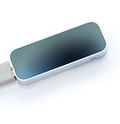


Motivation

Slide 3
Challenges
Space invariance
Generalizable to different environments
Computationally efficient

Slide 4
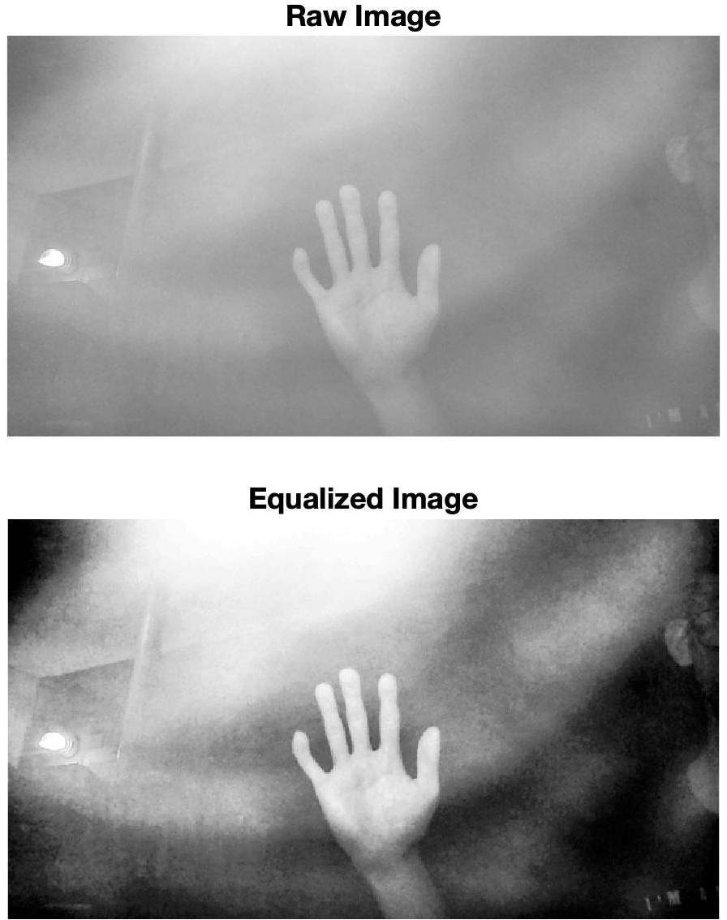
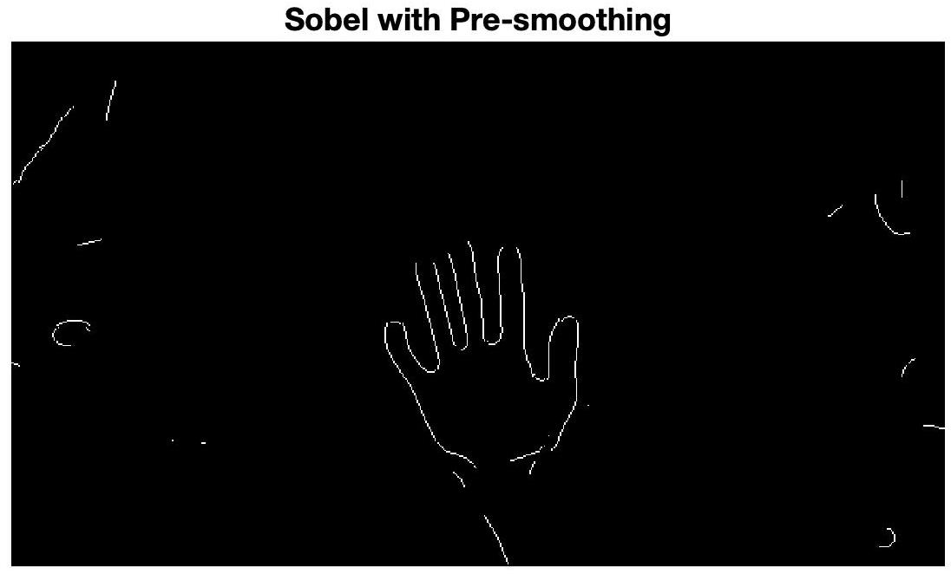
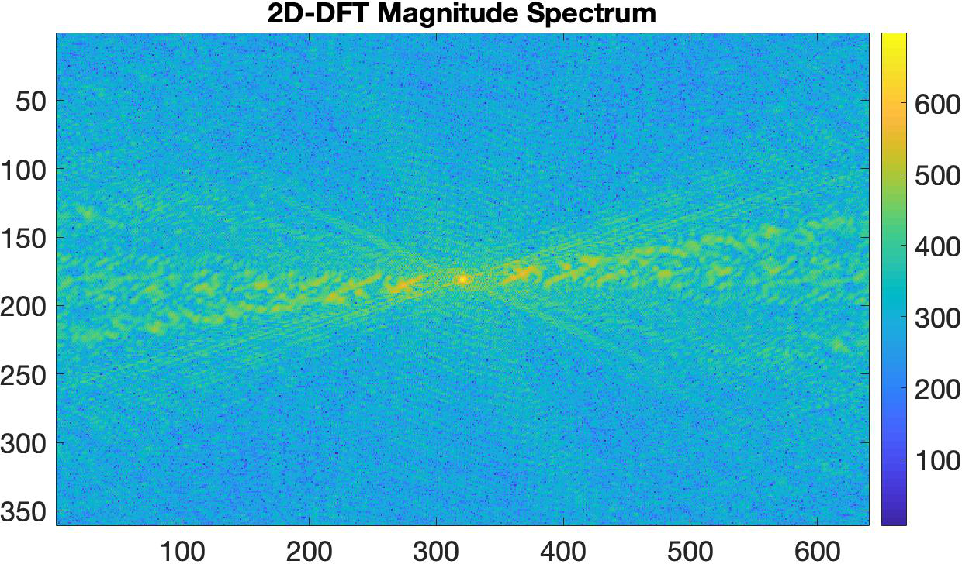
Spatial Invariance

Slide 5
Extracting Features
DFT

Slide 6
Extracting Features
DFT
Transformed DFT
0
degrees

Slide 7
Extracting Features
DFT
Transformed DFT
0
20
degrees

Slide 8
Extracting Features
DFT
Transformed DFT
0
20
51
degrees

Slide 9
Extracting Features
DFT
Transformed DFT
0
20
51
90
degrees

Slide 10
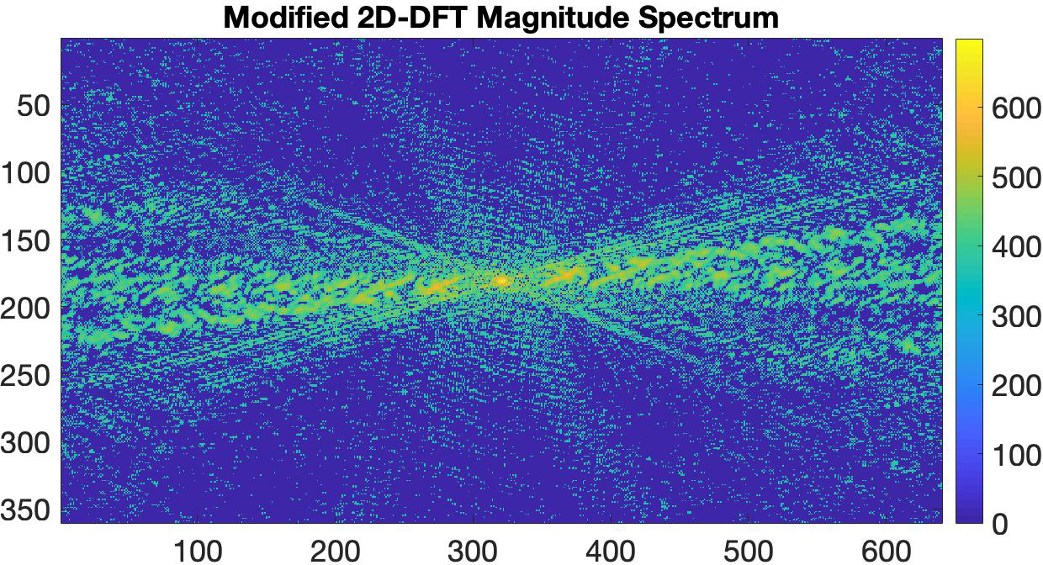
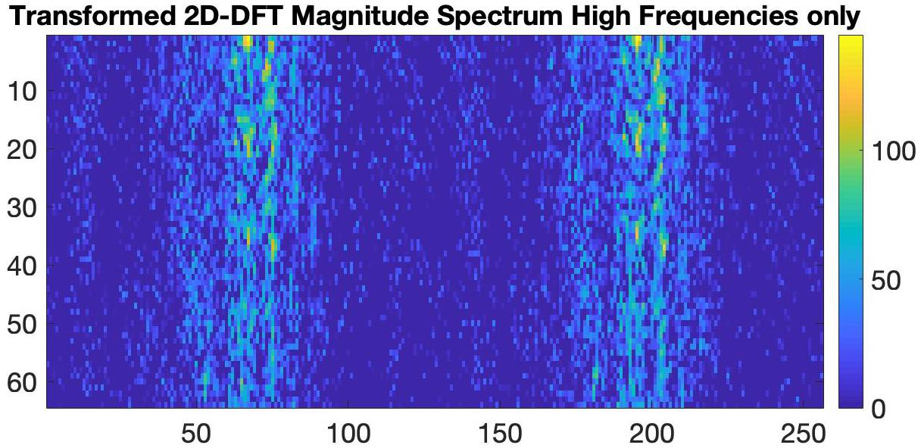
Extracting Features
DFT
Transformed DFT

Slide 11
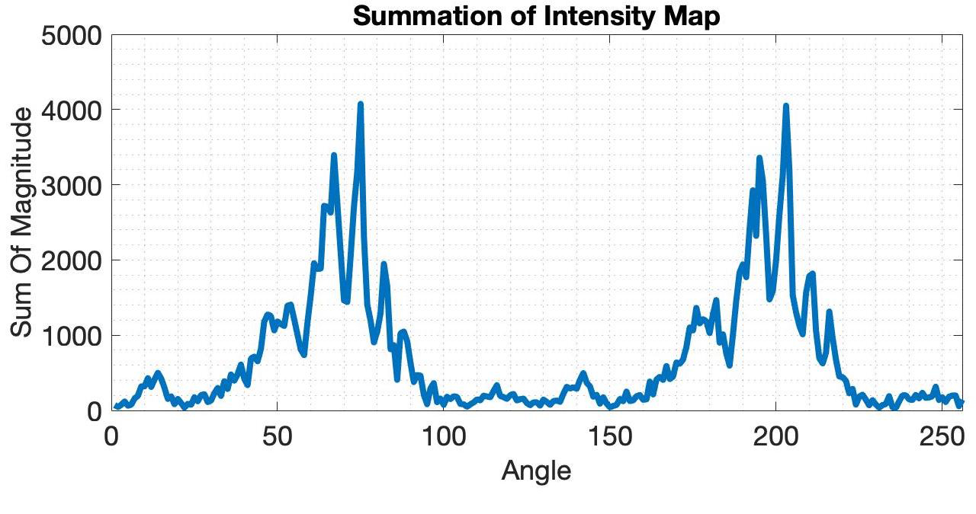
Extracting Features (continued)

Slide 12
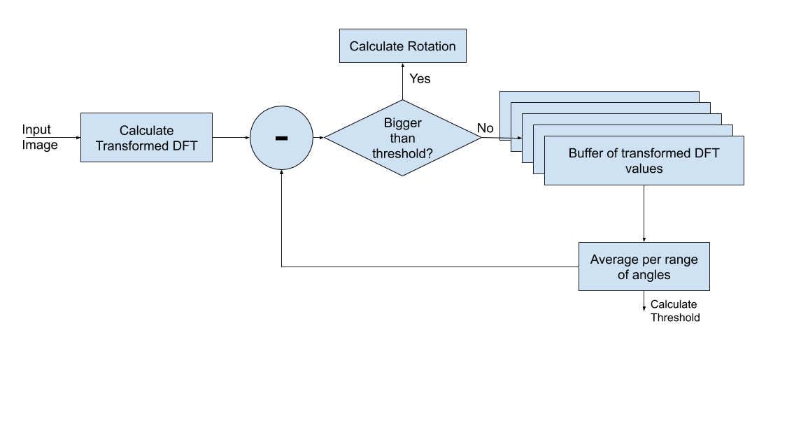
Removing Unwanted Peaks

Slide 13
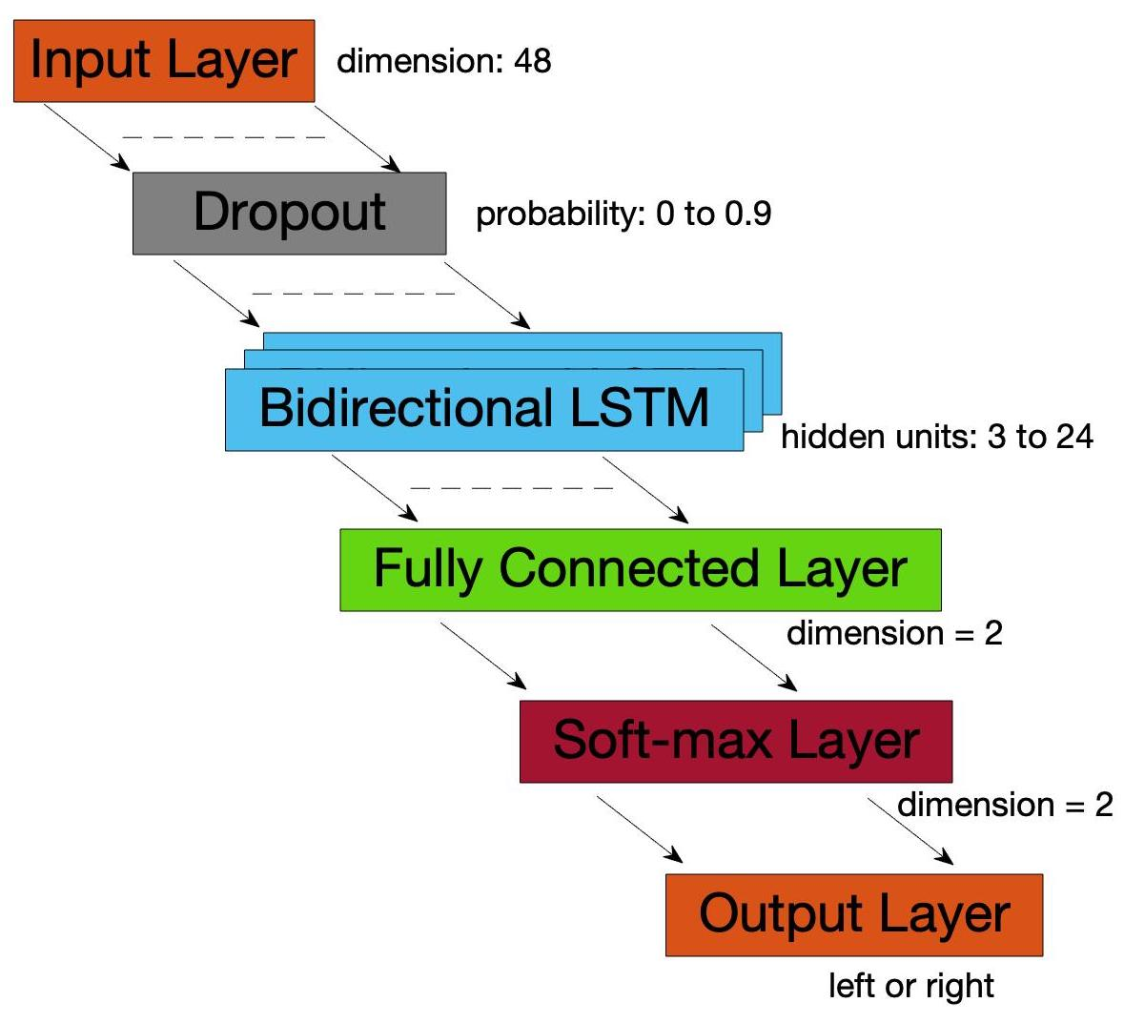
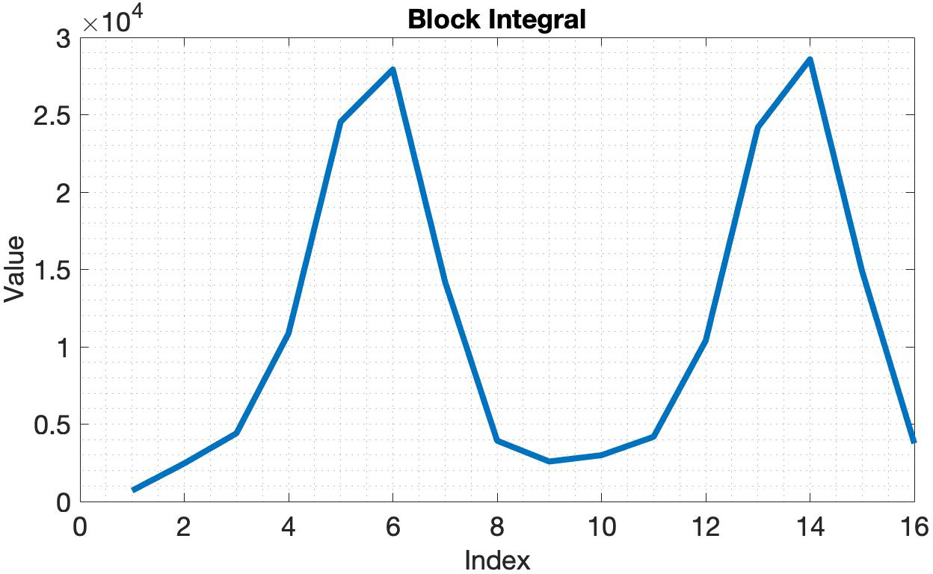
Training Neural Network

Slide 14
Results
90% validation accuracy after 500 epochs.
Final system uses constant thresholds to determine stationarity of hand and presence of hand and the neural network to determine left or right rotation (this is due to the poor quality training data).

Slide 15
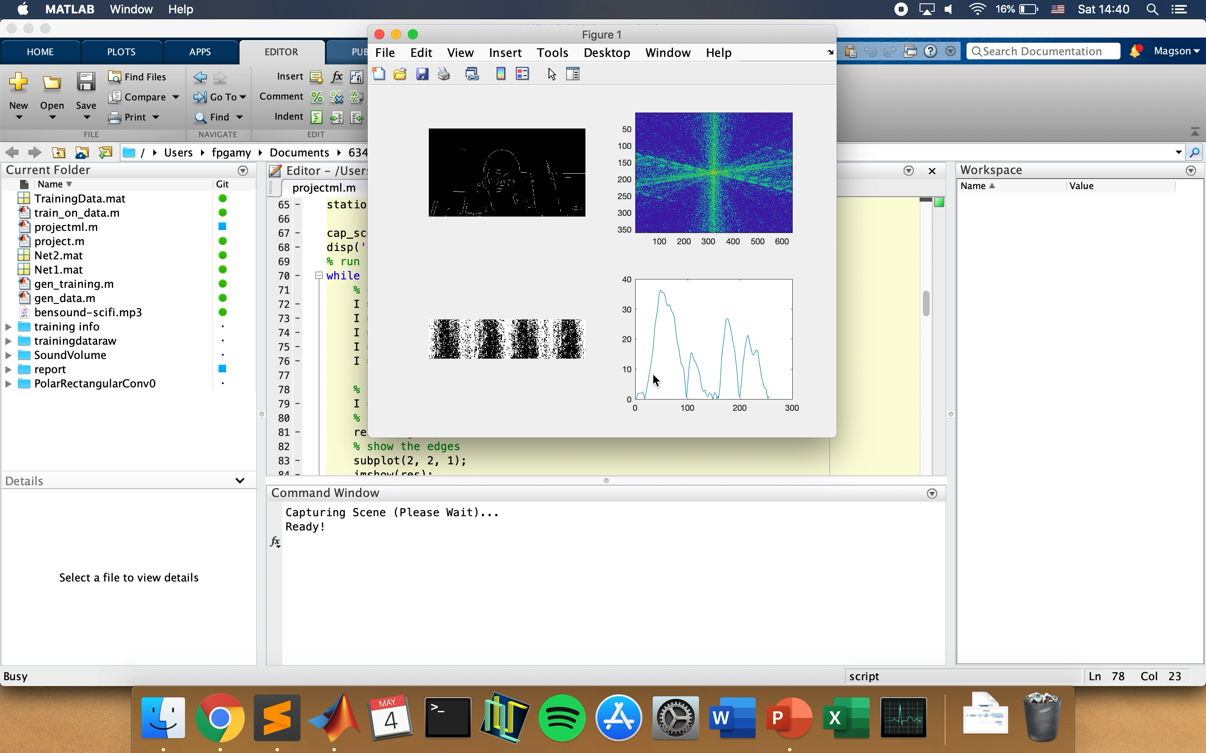
Results

Slide 16
Future Work
Currently detects hand rotation but not does not do gesture detection.
Can only detect a single hand- this could be extended to multiple hands with block processing.
With better training data and more epochs system could perhaps determine speed of rotation.

Slide 17
Thank you for your attention.
Any Questions?

